Slide 1
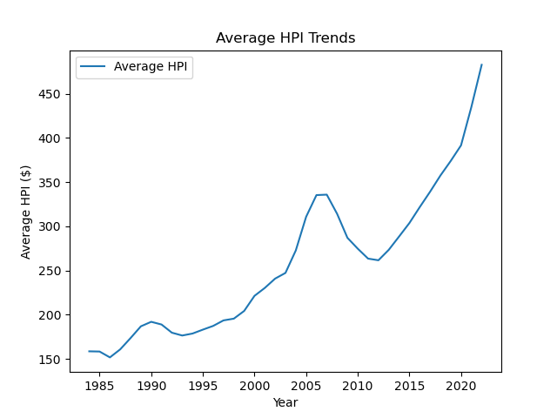
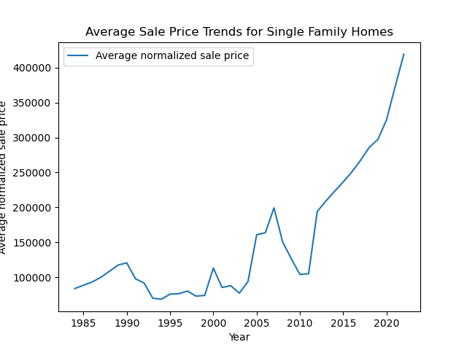
Housing Prices and HPI Trends Over Time

Slide 2
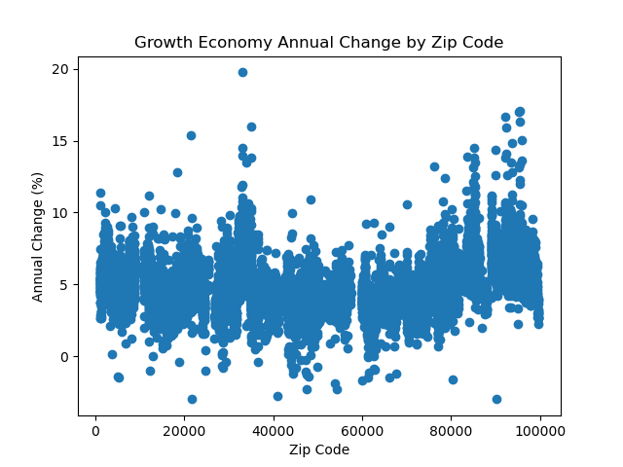
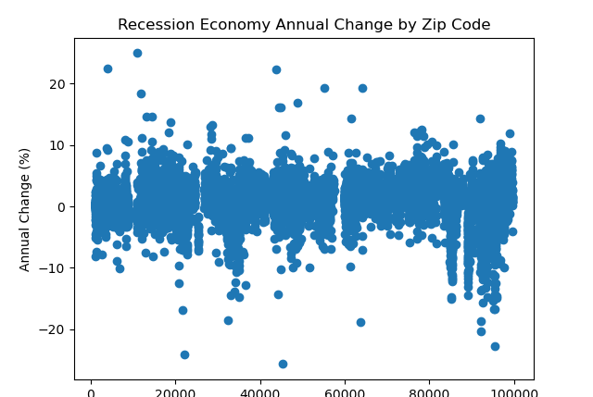
Annual Change (%) in HPI by Zip Code

Slide 3
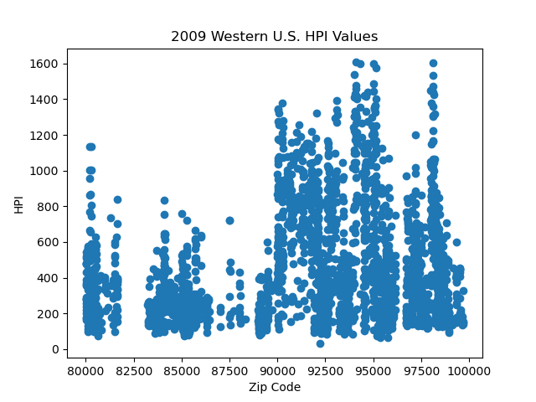
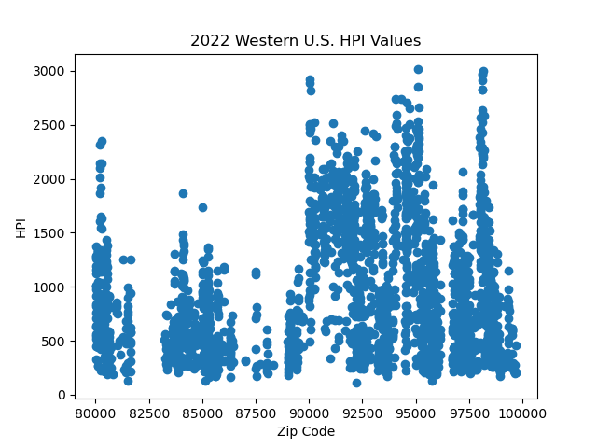
U.S. HPI Value Comparisons
Western U.S. zip code data includes WA, OR, CA, ID, UT, NV, AZ, NM, CO, & WY

Slide 4
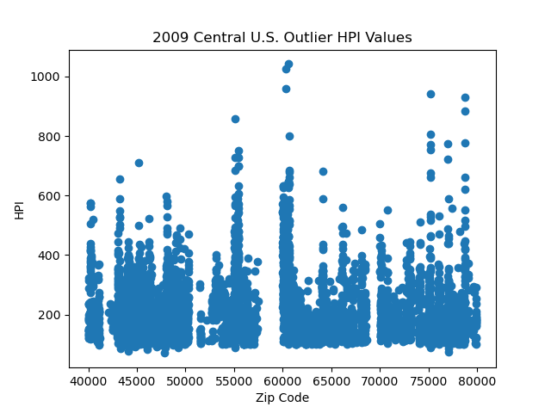
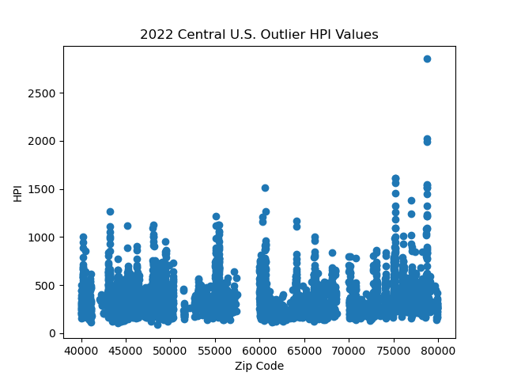
U.S. HPI Value Comparisons
Central U.S. zip code data includes MT, ND, SD, NE, WI, MN, IA, KS, OK, TX, LA, AR, MO, IL, IN, MI, OH, and KY

Slide 5
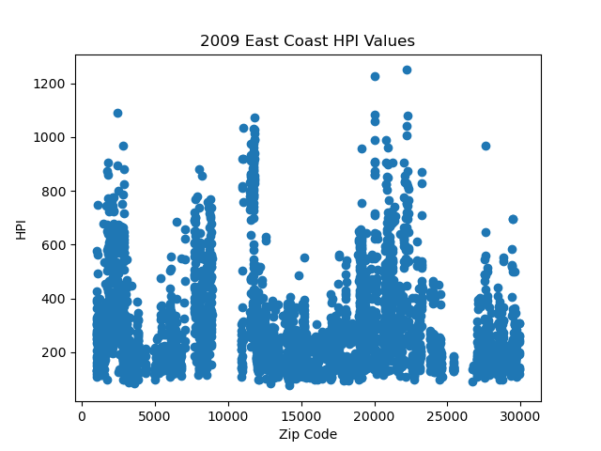
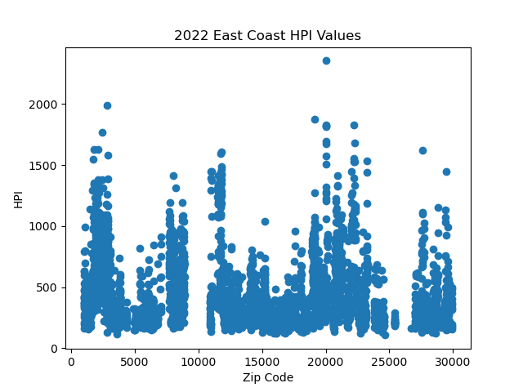
U.S. HPI Value Comparisons
Eastern U.S. zip code data includes ME, NH, VT, MA, CN, RI, NJ, NY, PN, MD, DC, WV, VI, NC, AND SC

